Slide 1
sddec20-05
Email: graysonc@iastate.edu

Slide 2
An Advanced Networking Outreach for Kids
Team Name: sddec20-05
Members: Austin Dvorak, Grayson Cox, Ryan Newell,
Ross Thedens, Spencer Parry, Malcolm Johnson

Slide 3
Problem and Project Statement
Wireless networks are now commonplace
K12 students use wifi regularly
Aren’t taught mechanics behind it
Opportunity to raise interest in computing
How to teach children about wireless technology?
Connect intangible signals to observable phenomena
Visually demonstrate functions with GUI
Portable wireless network nodes
Relay nodes
Sensor nodes
Network master node
User application
Show network statistics and sensory data
Network configuration
Lesson plans
Notes:
Wireless internet access is now available practically everywhere. Smartphones are ubiquitous, even among K12 students. But few understand the technology and methods behind wireless networking. Introducing K12 students to these concepts can increase interest in networking and related fields.
Our project is to make a teaching toolkit consisting of a set of wireless networking nodes that, when powered on, form an ad-hoc network. Some of these nodes will have sensors or cameras that provide data to be sent through the network. And one of these nodes will act as the “Network Master” node, which serves as the destination for all data in the network.
The system will be monitored by a web-based user application hosted on the network master node. This application will visualize network statistics and sensory data to a display. The intent is that students will be able to move the nodes around an open space and observe how physical distance and obstructions affect the quality of the network connection. The user application will also allow some network configuration.
We will also prepare a small set of lesson plans that will aid the instructors in conducting the activities.

Slide 4
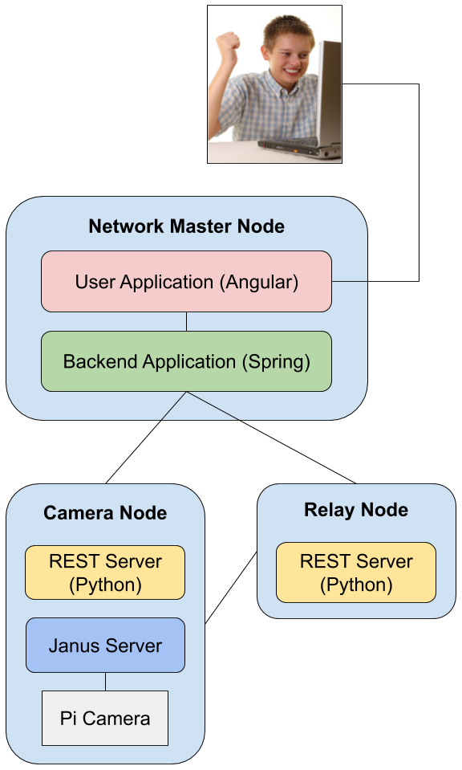
Completed Work
Network Configuration
Setup scripts for each node type
Wireless access point
Camera Node
Capturing live video
Janus WebRTC server
Node REST Server
API for fetching and modifying static node properties
User Application
Live view of nodes in network
WebRTC video streaming client
Backend Application
REST API for communicating with individual nodes
Currently serves mocked data for testing purposes
Notes:
Network configuration
In the networking side of things, we have written scripts that, when run on the Raspberry Pi’s, successfully create and setup a mesh network and run the software unique to each node type. This also sets up a wireless access point that allows a computer to connect to the network master node.
Camera Node
We have set up a prototype using a basic Pi camera. This node hosts a Janus server that serves the live video feed as a WebRTC stream. This is 100% functional currently when connecting the camera node to the network master node directly, but we’re still resolving issues with sending the video across the mesh network.
Node REST Server
This is a basic Python REST server that will be hosted on every node. It provides methods for fetching and modifying a node’s properties via HTTP.
User Application
This is a primitive Angular application hosted on the network master node that allows the user to view all the nodes in the network and their static node information, such as names, types, and IP addresses. It also supports WebRTC video streaming for displaying live camera feed from the camera nodes.
Backend Application
This is a Spring Boot application also hosted on the network master node. It provides a REST API for the user application for viewing and configuring nodes in the network. It basically serves as an API gateway, communicating with each individual node’s REST API so that the UI doesn’t have to handle the complex networking logic.

Slide 5
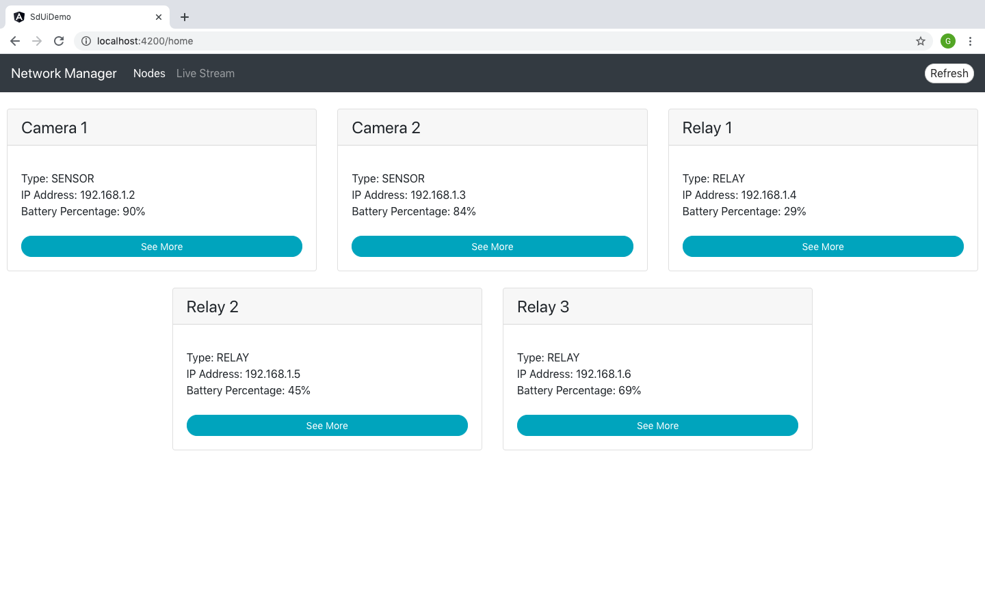
Notes:
This is a screenshot of our user application’s home page. In this page, the UI sends an HTTP request to the Spring Boot application to fetch a list of all the nodes in the network. The data shown here is sample data, since we are still working through some networking issues that Austin will discuss later. But when this is finished, the backend application will do an nmap scan to find all the nodes in the network, communicate with each node to fetch its properties as a JSON object, and then return all the JSON objects in an array to the user application.

Slide 6
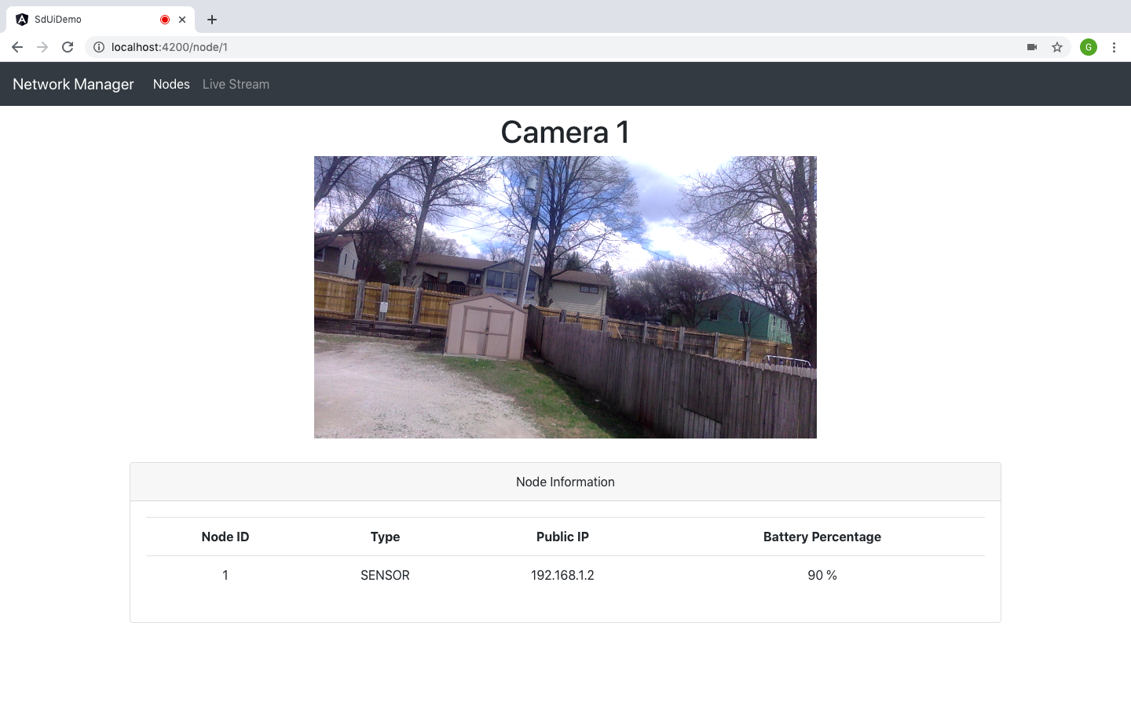
Notes:
After the user selects one of the nodes, the app will display this page, which shows static node information. If the node is a camera node, then the live video feed will be displayed here also. This is where the user application will connect to the Janus WebRTC server running on the camera node.

Slide 7
Technical challenges - Networking
The components don’t work together yet.
Mesh network and wireless interface are not communicating with each other
Backend doesn’t properly return the list of nodes on the network

Slide 8
Remaining goals for this semester
Finish assembly
Batteries and cases
Camera and mount
UI/UX Changes
Issue commands from master node to nodes
Allow for certain properties, such as the name of the node, to be edited from the UI
Simplify startup process to allow for a better user experience
Complete Documentation
Detail each component
Instructions for set up and use
Notes:
- Documentation
- Component descriptions
- Setup and running instructions
- Add support for configuring nodes via the UI
- Fully integrate components
- No longer doing lesson plans
- Get equipment
- Find the missing camera
- Setup batteries
- Get Pi cases

Slide 9
Future Group Work
Automated Start and Configuration
Network Setup
Start Applications
Race Conditions
Other data
Network Statistics
System Statistics
Lesson Plans
Activities for Students
Notes:
There are several aspects of the project that will need to be carried on by a new senior design team after the end of this semester. Perhaps most importantly, our network setup needs to be fully automated. We spent a lot of time this semester working on deploying batman-adv on our nodes. Most of this configuration involves commands entered manually in a terminal. While it would be easy to write a bash script to execute these, the setup is multifaceted: after the nodes are configured, the backend application, user application, and camera stream need to be launched; the REST server needs to be launched on each node as well. Race conditions will inevitably occur, as some nodes may complete their setup faster than others. Messaging between nodes via ZeroMQ or a similar technology will help alleviate this.
It would also be beneficial to capture and display more information from the network nodes, including network statistics such as packets received by each node, and system statistics such as the temperature of each node.These could be acquired by the backend application via the REST servers and displayed in the user application. A future group will need to complete the set of lesson plans for the project as well. These will include activities for students to do with the mesh network. These will need to wait until the end because they are dependent on the final configuration of the project’s main components.

