Slide 1
An Advanced Networking Outreach for Kids
Team Name: sddec20-05
Leader: Grayson Cox (graysonc@iastate.edu)
Members: Austin Dvorak, Ryan Newell, Ross Thedens, Spencer Parry, Malcolm Johnson

Slide 2
Problem Statement
Wireless networks are now commonplace
K12 students use wifi regularly
Aren’t taught mechanics behind it
Opportunity to raise interest in computing
How to teach children about wireless technology?
Connect the intangible signals to a physical object
Use real world data
Visually demonstrate functions with GUI
Notes:
Wireless internet access is now available practically everywhere. Smartphones and similar devices are extremely common, even among K12 students. But the people using it, especially children, don’t understand the technology and methods behind wireless networking. If K12 students could be introduced to the concepts involved in running these networks, certainly more will go into careers involving computing and networking.
So, what is the best way to introduce young students to wireless technology? To enable easy understanding of wireless systems, students should be able to tie the intangible signals to a physical object that can be interacted with to change the behavior of the system. Using real world data would improve the learning experience by allowing children to see changes in real time. Finally, displaying information on a GUI will simplify any activities for both students and teachers.

Slide 3
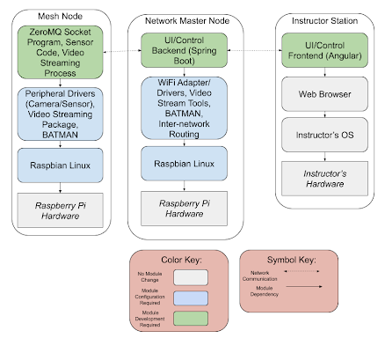
Project Statement
Portable wireless network nodes
Relay nodes
Sensor nodes
Network master node
User application
Show network statistics and sensory data
Network configuration
Lesson plans
Notes:
Our project is to make a teaching toolkit that will give teachers and students hands-on experience with wireless networking.
First, there will be a set of wireless networking nodes that, when powered on, form an ad-hoc network. Some of these nodes will have sensors or cameras that provide data to be sent through the network. And one of these nodes will act as the “Network Master” node, which serves as the destination for all data in the network.
There will be a web-based user application hosted on the network master node. This application will visualize network statistics and sensory data, such as video streams, to a large display. The intent is that students will be able to move the nodes around an open space and will see how physical distance and obstructions affect the quality of the network connection. The user application will also allow some network configuration.
Lastly, we will prepare a small set of lesson plans that will aid the instructors in conducting the activities.

Slide 4
Goals for this semester
Order remaining parts
Assemble nodes
Finish configuration setup
Networking
Node setup
Complete master node-client computer communication
Finish Angular App
Create a Docker Compose
Launches backend and frontend images at the same time
Allows for easier deployment
Deploy the images onto the nodes
Test the final configuration

Slide 5
Technical challenges - Video Streaming
Requirement for video streaming from camera nodes to instructor station
Acceptable resolution, framerate, latency
Many existing protocols, containers, codecs
RTP, RTSP, MPEG-DASH, WebM, WebRTC, MJPEG
H.264, H.265, VP8
Compatibility, Implementation issues
VLC plugin unsupported in modern browsers
MPEG-DASH, WebRTC difficult to use
MJPEG latency unacceptable
Notes:
One of our primary technical challenges has been video streaming from the camera nodes to the instructor station. The primary goal is to provide a stream where students can recognize each other from the feed and get the sense of a continuous view across the network. We are targeting a resolution of at least 300x300, a framerate of at least 3 frames per second, and a latency of at most 2 seconds from the camera to the instructor station feed.
We looked at many video streaming protocols, containers, and codecs to accomplish this. Initially, we wanted to use the open source VLC web plugin from VideoLAN, as it would allow us to easily run protocols such as RTP and RTSP. Unfortunately, it has not been maintained and is incompatible with modern browsers. More modern solutions, such as MPEG-DASH (Dynamic Adaptive Streaming over HTTP) and WebRTC, would require us to create complex configurations and implement parts of the protocols ourselves. MJPEG required minimal setup, but the latency was unacceptable.

Slide 6
Technical challenges - Video Streaming
WebRTC
Lowest latency
Widest compatibility
Janus WebRTC gateway
JavaScript API
FFmpeg
H.264 supported
Minimizes stuttering
Docker
Handle dependencies for Janus, FFmpeg
Easy to access camera hardware, host network interface
Notes:
Ultimately, we selected WebRTC as our video protocol. It performed better than the other options we tested, and has broad compatibility with the latest versions of Firefox and Chrome. As shown in the diagram, the Janus WebRTC Gateway converts our H.264 RTP stream to WebRTC. On the client side, Janus provides a JavaScript API and documentation for interacting with the Janus gateway that does not require the developer to deal directly with the inner workings of WebRTC, such as establishing a signalling server and handling the session description protocol (SDP) file.
FFmpeg is used to create the initial video stream on the camera node. It provides H.264 support, which is easy to use with Janus, and does not suffer from the same stuttering issues as GStreamer.
We created a Docker container to ease the deployment of Janus and FFmpeg on our camera nodes. It handles our dependencies automatically and provides transparent access to the camera module and host network interface, and the results are virtually identical to running Janus and FFmpeg directly on the Pi.

Slide 7
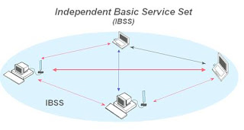
Technical challenges - Networking
-BATMAN-ADV
-Kernel Level
-Layer 2 mesh network packet routing
- Runs on any linux system
-Separate physical interfaces from software routing
-Rpi4 wireless did not allow for IBSS
-Most documentation was for RPI3 and before
- Initially interfaces would not integrate with hardware devices

