Slide 1
Lightning Talk #2 An Advanced Networking Outreach Activity for Kids
sddec20-05: Austin Dvorak, Ryan Newell, Ross Thedens, Grayson Cox, Spencer Parry
Notes:
Ross Thedens:
Ad-libbed intro

Slide 2
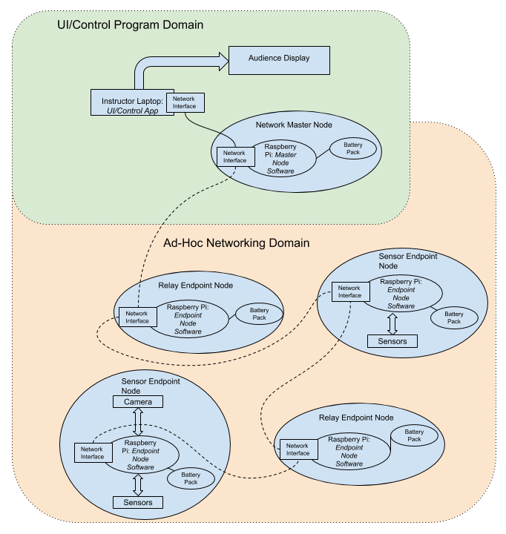
System Overview
Node Types
Network Master
Endpoint
Sensor
Relay
Connection to UI/Control App
Display Data
Control Flow
Notes:
Ross Thedens:
I’m Ross Thedens, and I will be giving the project overview. Our project’s main goal is to provide an ad-hoc network demonstration with portable nodes. These nodes consist of a Raspberry Pi Single Board Computer, a network interface card, a battery pack, and optionally sensors and cameras. One node, the network master node, maintains a fixed connection to an instructor’s laptop, which runs a user interface application responsible for displaying the data transferred through the network and issuing control commands. The rest of the nodes are Endpoint nodes, which are connected to one another and the network master node in an ad-hoc network. Some endpoint nodes are sensor nodes; they may have sensors and/or a camera connected to them. Others serve as only relay nodes allowing data to flow through the network. The network master node is connected directly to an instructor’s laptop, which runs the user interface and control program. This program displays network statistics and data on a screen and allows users to send commands through the network.

Slide 3
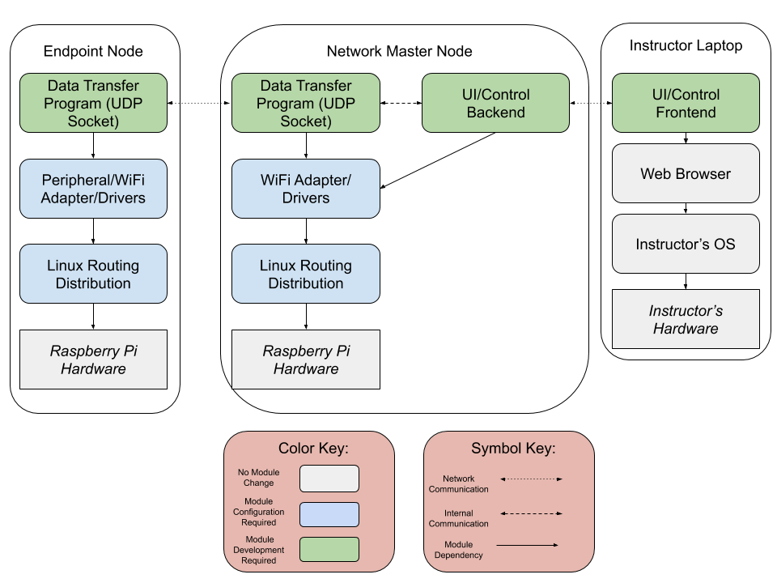
Software Overview
Layered Architecture
Constructing the System
Software Development
Downloadable Packages
Existing facilities
Notes:
Ross Thedens:
Our project software consists of a series of layers on each different type of device involved. In the diagram shown, green modules represent software that will be developed as part of the project, blue modules represent packages that will be downloaded and installed, and rounded gray modules represent software provided by the instructor. The square gray modules represent the underlying off-the-shelf hardware. Each endpoint node consists of a Raspberry Pi board which runs an ad-hoc routing-capable distribution of Linux. On top of this, we must install the required drivers for sensors, cameras, and wireless network interfaces. At the top, we have a simple data transfer program for sending the data via a UDP socket. The network master node consists of these same layers, but it also runs the UI/Control program backend, which delivers data and receives control signals from the UI/Control frontend (on the instructor’s laptop in a web browser).

Slide 4
Relay Nodes
Forward packets to correct location
OpenWRT on Raspberry Pi’s
BATMAN or OSLR for ad-hoc mesh networking
Should automatically connect nodes to network as they become available
Notes:
Austin Dvorak:
Hello I am Austin Dvorak and I am the Network Systems Manager. The purpose of the relay nodes is to allow for a greater distance between the base station and the sensor nodes. These nodes will simply forward packets from the sensor node to the base station, which is the final relay node that is connected to the user’s laptop. The base station will be running a webserver that will serve up a user interface. The Relay nodes including the base station will be running OpenWRT, a routing firmware that will aid in setting up an automated ad-hoc network. To create the network, we will either be using BATMAN or OSLR, two different ad-hoc networking protocols. Each of these are proactive Ad-hoc protocols, meaning they create a route table on initialization and continuously update the table as nodes are dropped or move within range. Both are supported on openwrt so experimentation will need to be done to decide on which protocol we will use.

Slide 5
Sensor Nodes
Includes a camera module
Streams video from camera to the network master
Behaves as a relay node as well as streaming video
Only difference is that it has a camera module and streams video
Notes:
Ryan Newell: I’m Ryan Newell and I”ll be going over the sensor nodes. These nodes act very similar to the relay nodes but with an extra purpose. Sensor nodes are outfitted with a camera module and can stream video from the camera back to the network master node. The video stream will be sent through the ad-hoc network back to the network master which will then stream that video to the instructor laptop for viewing. This is show that data can be sent through the network and users can see the signal strength changing based on the video quality. As relay nodes are introduced and moved around, the signal might become weak and start to experience packet loss causing video to not be continuous. For example, if the path to the network master is changed have to go through a thick wall the video may start to lose frames and get “jumpy”.

Slide 6
User Display
Display sensor information from the network
Allow users to control certain nodes
Add or remove nodes
Easy to use
Notes:
Spencer Parry:
Hi my name is Spencer Parry and I am one of the Chief UI engineers on the project. The purpose of our user display is to allow the user to view statistics about the mesh network, control certain aspects about each node, or add or remove a node from the network. The user interface will need to be very user friendly, as middle school students are one of the potential target groups for the project. We are planning on developing the GUI using Angular, and are planning on deploying it onto the main node that will be running a webserver to allow easy access to the GUI via a web browser.

Slide 7
Timeline
March: Begin experimenting
May: Have network prototype complete
Be able to send and receive data
Ad-hoc
August 23: Begin final design
September: Finish relay nodes
October:
Have functioning sensor nodes by October 15
Deliver functioning UI
November:
Improve UI
Prepare presentation
Notes:
Grayson Cox:
My name is Grayson Cox, and I am a UI developer and the Agile project manager for this project.
Here is an overview of our timeline:
As of this month, we have begun experimenting with our own hardware, and we hope to do more in-depth experiments as soon as we receive our equipment from ETG.
By the end of May, we will complete prototypes for our ad-hoc node network. This includes being able to send and receive data across our network.
In late August, the start of the fall semester, we will begin implementing our final designs for the forwarding nodes, sensor nodes, base station and user interface.
We expect to finish the forwarding nodes by the end of September, and have some functioning sensor nodes by October 15. Also in October, we will deliver a functioning UI.
Lastly, we will spend the month of November improving our UI and preparing our final presentation of the project.

Slide 8
Thank You
Notes:
Ross Thedens:
Ad-libbed conclusion

