Slide 1
An Advanced Networking Outreach Activity for Kids
Client/Advisor:
Team:
Dr. Tom Daniels
Grayson Cox, Austin Dvorak, Ryan Newell, Spencer Parry, Ross Thedens
Notes:
(Ross Thedens)
This is Team 5’s (sddec20-05) final presentation for CprE 491: Senior Design. We are Grayson Cox, Austin Dvorak, Ryan Newell, Spencer Parry, and Ross Thedens

Slide 2
Project Plan

Slide 3
Problem Statement
The Internet has become a fundamental part of our lives.
People generally have a very abstracted understanding of what the Internet is and how it works.
Our goal is to provide an activity for kids to help give them a better understanding of what goes into the operation of the Internet.
Notes:
Ryan Newell:
Over the years, the Internet has become more and more ingrained into everyday life. Just about everyone uses it multiple times each day, yet not many understand what the Internet really is or how it works. Many think that the Internet is just there and it just works, but there is so much that goes into make sure that data gets to and from devices and is reliable. Having an idea of how it all works is beneficial as it will give people a better understanding and hopefully give them a better appreciation of what is going on. Our goal is help kids get that understanding by letting them dive into networking and routing without getting technical.

Slide 4
Solution Statement
Give kids a hands-on activity that demonstrates properties of a computer network.
Create a set of nodes that route data and provide an interface to display that data and statistics of the network.
Nodes can be arranged to extend the network or get around obstacles that interfere with the signal.
Lessons that give a challenge that the kids have to solve using the nodes.
Notes:
Ryan Newell
The goal is to teach kids about networks and how data gets from one place to another. Our project is an activity where kids can arrange nodes and see how the nodes connect to each and how data is routed from one node to their computer.
We are creating a set of nodes that transmit data such as live video that the kids can pull up on their computer. To simulate how data is routed through servers and data centers around the world, kids will be tasked with a challenge such as trying to view video from a node that is too far for the signal. Using the nodes they’ll have to arrange them in a way so that the signal can travel from the camera all the way to their laptop.
They can play around with the nodes to see how the network works but also there will be lessons that give different challenges that they have to try and solve using the nodes.

Slide 5
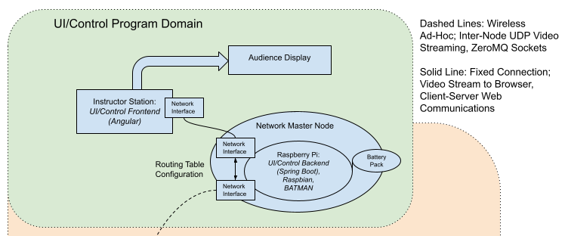
Conceptual Sketch
Notes:
Ross Thedens:
Our conceptual sketch divides the project into two domains: The Ad-Hoc Networking Domain and the UI/Control Program Domain. Within the UI/Control Program Domain, the instructor’s station (typically an average grade-school teacher’s laptop) is connected to the Network Master Node using a network interface (either WiFi or Ethernet). The instructor station runs an Angular web app (which we call the UI/Control Program or user application for short) that displays sensor data, camera streams, and statistics from the network. It can be connected to an external Audience Display. The Network Master node runs the Spring Boot backend and serves as a base station for the ad-hoc network.

Slide 6
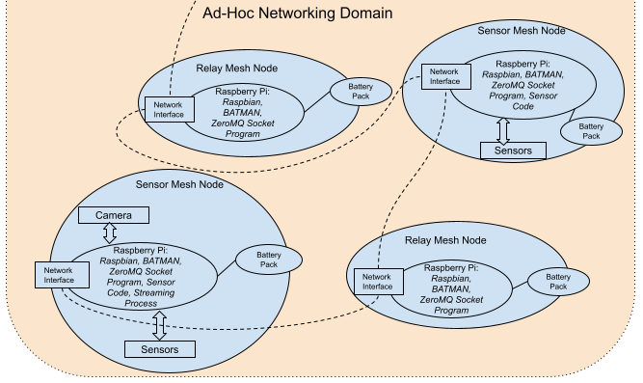
Conceptual Sketch
Notes:
Ross Thedens:
The Ad-Hoc Networking Domain consists of several types of mesh-networked nodes (also referred to as “ad-hoc”). The most basic are Relay nodes. These form the backbone of the ad-hoc network by forwarding data to its destination. The Sensor nodes contain peripherals such as temperature sensors. A user can view these nodes’ data captures in the user application, provided they are connected to the network. Some Sensor nodes also have a camera module. The user can view the camera stream by selecting it in the user application. All nodes are connected to battery packs to enable mobile operations. All of these nodes will be running Raspbian Linux and the BATMAN ad-hoc networking protocol.

Slide 7
Functional Requirements
Nodes should be mobile
Powered by rechargeable batteries
Battery should last long enough for two hours of use
Wireless, easy to move
Not require an Internet connection
Nodes should have full functional capabilities without the need to connect them to the Internet
Should be robust and simple enough to use and setup that any instructor can run this activity
Notes:
Ryan Newell:
Our three big functional requirements are node mobility, having a standalone network, and being intuitive enough for anyone to use.
First, to be able to allow the freedom of rearranging the nodes and extending the network the nodes must be mobile. In regard to this project, mobile means wireless and self-contained. Each node needs to have a rechargeable battery to eliminate need for a power cord. This battery should allow for a minimum of two hours of use so that there is ample time to for kids to try different things. All components will need to be self-contained so that nodes are easy to move around. The second requirement is that the activity should operate without any need for an Internet connection. This removes any configuration need to set up and get the nodes connected to the Internet. It also allows the nodes to be used anywhere since they won’t be restricted to areas covered by a wireless network.
Moving on to the next requirement, nodes should be robust and simple to use. This project is intended to be administered by any instructor and should assume that they have no technical knowledge. An instructor should be able to turn on each node and setup the Network Master Node with minimal instruction or trouble.

Slide 8
Non-Functional Requirements
Network stream should have low latency (<2 seconds)
Nodes should be durable enough to handle low (<5 feet) drops
Network should allow for the easy addition of nodes
Should handle interference without severely affecting performance of the network
Code should be well documented and follow testing guidelines
Notes:
Austin Dvorak:
Hello my name is austin dvorak and I will be discussing the non-functional requirements. Non functional Requirements for this project are as follows The network streams, such as live video, should have a low latency of less than 2 seconds, The nodes should be able to handle low drops from standing height less than 5 feet, the network should allow for the easy addition of nodes as needed as well as connect and disconnect nodes automatically when they get in and out of range. In enclosed spaces like gymnasiums, the network should handle interference without severely affecting performance of the network. Finally, the code should be well documented and tested.

Slide 9
Other Constraints/Considerations
Third-party software tools must be open-source.
User application must be supported by the user’s browser.
All work must be completed by the end of the 2020 fall semester.
Notes:
Grayson Cox:
Other constraints we will want to consider will be that all third-party software tools we use must be open-source. We do not want to use any proprietary resources for this project.
The user application must be able to run on the user’s computer. In other words, the user must supply his/her own machine with a browser capable of running the user application.
Additionally, since this is a senior design project, all work must be completed by the end of the 2020 fall semester.

Slide 10
Market Survey
Virtualized solutions exist
Network simulators (ns-3)
Physical SBCs benefit students
Prior experiments
Raspberry Pi, 802.11 WiFi
Addition of video
Our Solution: Low Cost & Customizable
Community resources & documentation
Maintainability
Notes:
Ross Thedens:
Our project has several important features that distinguish it from similar products and experiments that have been developed in the past. Many teaching tools for ad-hoc networking involve virtualized networks, such as the ns-3 network simulator. These often are configured and run on the command line. Despite the virtues of low cost and compatibility with a wide array of hardware, virtualized solutions will require students to visualize the network on their own; a tangible physical network is much more appropriate as an introduction. In addition, these tools may require the instructor, who is not necessarily tech savvy, to enter commands for configuration.
Our idea of using Raspberry Pi single board computers (SBCs) and WiFi has been tested before by Edoardo Biagioni from the University of Hawaii. Biagioni’s experiment involved four Raspberry Pis running a specialized mesh networking operating system. Our project adds the camera module to provide a more interesting data source for students. It also uses the common Raspbian Linux distribution to ensure long-term maintainability. Our project’s use of Raspbian ensures that we will have access to a trove of community resources and documentation for development and maintenance

Slide 11
Potential Risks & Mitigations
Online Instruction
Software oriented project so work can be done outside of labs.
Client meetings and weekly status report meetings done through Zoom.
Incompatible Hardware/Software
Have multiple backup technologies that can be used.
Started testing technologies early, have until october before it becomes a concern.
Notes:
Austin Dvorak:
Hello, my name is austin dvorak and i will be discussing the potential risks and mitigations.
COVID-19 has presented a major risk as all of the on campus labs are closed and all group work must be done virtually to maintain member safety. Since our project is mostly software oriented, the only hardware we are dealing with are cheap single board computers and cameras, all of which have been obtained, so everyone can do testing and prototyping of the project from their homes.
We have taken to using zoom for any meetings between members and our client/advisor so we have not noticed a decrease in communication since instruction has gone online.
The other main risk we have is incompatible hardware and software. Since raspberry pi mesh networks have been done but aren’t well documented, there may be incompatibilities between certain softwares. Our plan to mitigate this risk is to always have multiple feasible technologies to use, like multiple supported linux Distributions, multiple Mesh protocols, etc, and start testing the second option whenever we run into issues. We have already had to change the linux distribution we have been using, OpenWRT due to package manager issues and interface configuration issues, and have since moved over to Raspbian

Slide 12
Resource/Cost Estimate
Equipment Plan
Raspberry Pi 4s
Accessories as needed
Open source software
Simple packaging
Fiscal Plan
Estimated total budget of ~$500
Price point of $60-$65 a node
System of 8 nodes
Notes:
Spencer Parry:
For our project, our plan is to use Raspberry Pi 4s as a base computer for each network node. From there, each node may have accessories, such as a camera, as needed. Throughout the project, in both the front end and the backend, we plan on using open source software to mitigate having to purchase software. We also plan on developing a simple packaging solution that provides protection in the determined operating environment, while also being cost effective.
Fiscally, we have an overall project budget of around $500. Each node will have a price point of $60-$65 depending on what accessories each specific node will have. We are planning on each base system configuration to come with 8 nodes including the network master node, putting the overall cost of a system at $480-$520.

Slide 13
Project Milestones & Schedule
Prototyping work for Spring 2020
Ad-Hoc Network
Video Streaming
Messaging/control
May stretch into summer
Implementation underway in Fall
Board Improvements (Battery, System Reporting)
Network Master Node software
User Interface
User manual & Lesson Plans
Notes:
Ross Thedens:
Our major project milestones for the end of the Spring semester were to implement a rudimentary mesh network on our Pis and implement a video streaming solution to capture video from a Pi Camera and stream it to an Angular web app. These milestones have been affected by the transition to online classes, and we are still working on both with the intent to finish them by the end of the semester or the week after. We have also made progress on the higher-level messaging techniques that will be used for nodes communicating with the user application.
Next Fall, we will complete our third milestone, installing the battery packs and reporting system statistics (including CPU and RAM usage) from the nodes. We estimate this will be completed in the first week of September. Our fourth milestone will be finishing the Network Master Node software and enough of the UI to request and display network statistics and show camera streams; this will be completed around the middle of October. Our fifth milestone is finishing the user interface, estimated by the end of November. Our final milestone will be the writing of a user manual and lesson plans, estimated by mid December (at the end of CprE 492).

Slide 14
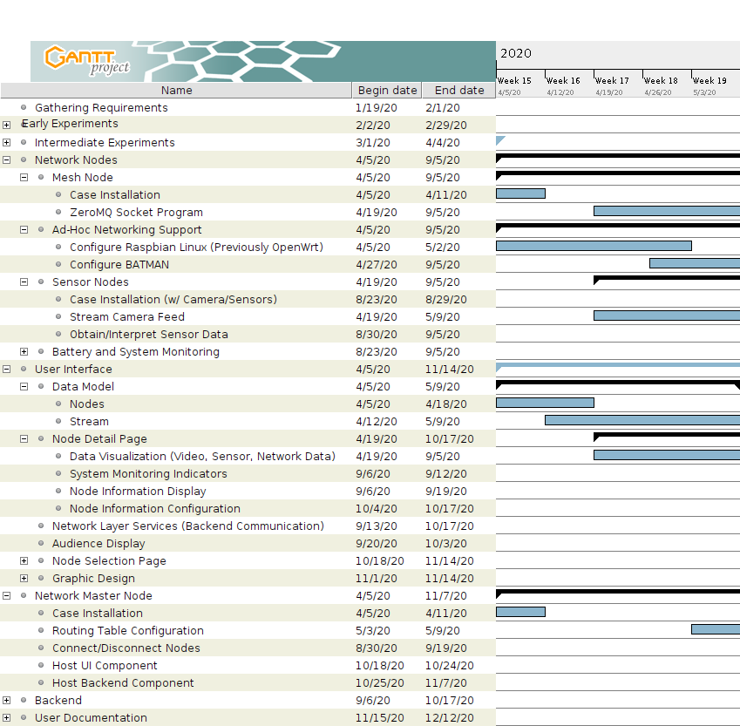
Project Milestones & Schedule
Notes:
Ross Thedens:
This is an excerpt from our Gantt chart from April fifth to May ninth. As shown, we will continue to work on the Raspbian and BATMAN configurations. Initial UI work for displaying sensor and network data will continue into the fall.

Slide 15
System Design

Slide 16
Functional Decomposition
User Application
Nodes
Sensor Nodes
Relay Nodes
Network Master Node
Hosts User Application & Backend
Mesh Connection to Nodes
Mesh Network Configuration
Node Hardware
Mesh Software
Notes:
(Ross Thedens)
This is the functional decomposition for our project. We will be going over each element in detail in the next slides.

Slide 17
User Application
Web-based application
Visualizes live and static data from network
Network topology
Network statistics
Video streams
Two displays
Control
Audience
Technologies used:
Angular
WebRTC
Notes:
Spencer Parry:
The user interface for this project will be a web-based application. This application will be used to visualize live and static data from the mesh network, such as the list of active nodes in the network, network statistics, and sensory data like video streams. This live sensory data will be shown either in the standard display mode, which shows other details about the node, or in audience mode, which projects the data graphically for many to see.
Regarding the technologies we used, our current prototype is written in Angular.
We also use WebRTC, which enables real-time video streaming in a web-based application. We chose WebRTC because we wanted to show the video feed in an embedded HTML video element, and the only other option was HTTP streaming using either HLS or MPEG-DASH, both of which incur too much latency for our project.

Slide 18
User Application Testing
Performance on the Network Master Node
Cross Browser Support
Usability Tests with the Target User Group
Notes:
Spencer Parry:
To test out the User Application side of our project, we plan on doing performance based testing on the Network Master Node, Cross Browser Support Testing, and Usability Testing with Target User Groups
The master network node will be used to run our Angular application, and once we have a finished front end, we will want to test the Master Network Node to make sure it can handle running the GUI as well as the other functions it has to perform.
Another test we will want to perform is browser compatibility. We will want to confirm that the application can be used without faults in all browsers, making it easy for the user to just open the application up.
Our final test will be that of usability. We will want to confirm that when we have a fully functional product, that the target user group can use the front end with ease.

Slide 19
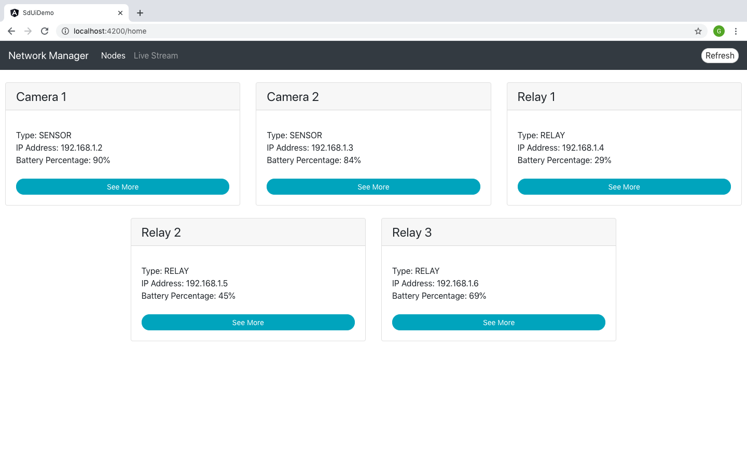
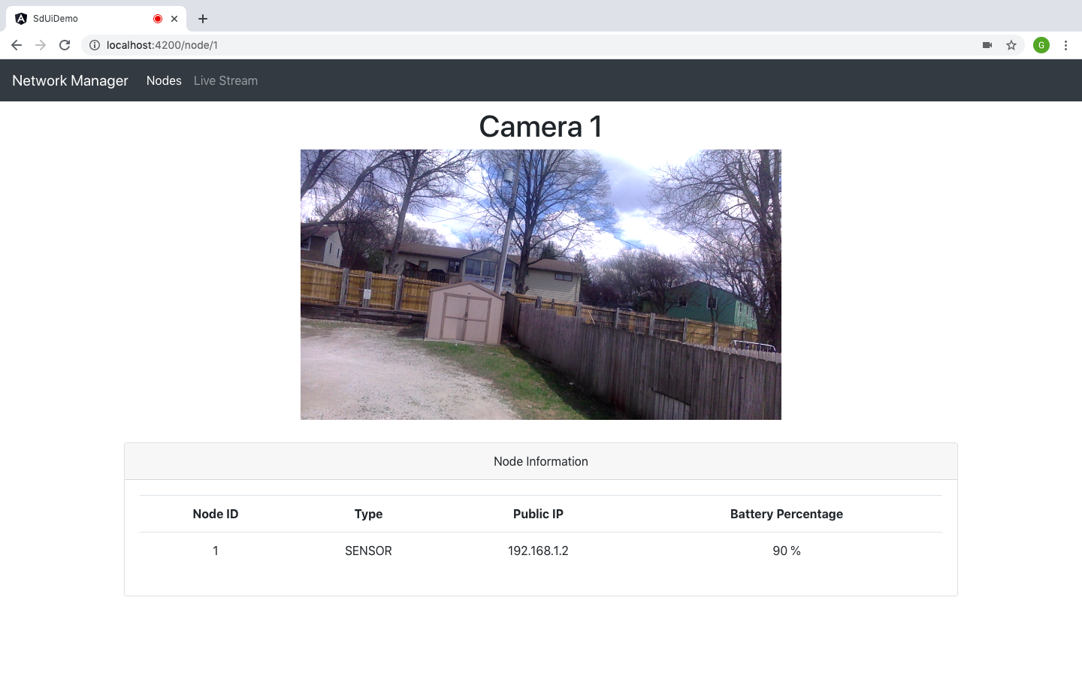
User Application Functional Prototype
Notes:
Grayson Cox:
Our current user application prototype consists of a home page displaying a list of active nodes in the network. Once a node is selected from the list, the application will display a detail page with node-specific information. The data shown in this prototype are being produced by a mock HTTP server. This mock server will eventually be replaced by a Spring Boot application running on the network master node.
This screenshot on the right is the detail page for a camera node. The page shows static node information as well as the live video feed. For a relay node, this page would display only the static node information.
The live video feed shown is sourced from the host machine’s web cam because this prototype is focused on the design of the user interface. Our efforts in creating live video streaming are showcased in our WebRTC signaling server prototype, which will be shown later in this presentation.

Slide 20
Node Design
Built with Raspberry Pi Model 4
Housed in a mobile, drop-proof case
Includes rechargeable battery
Running Raspbian with a custom configuration
Notes:
Ryan Newell:
Each node is designed to be a self-contained system built with Raspberry Pi Model 4. Along with the battery, sensors, and other components, the Raspberry Pi will be packaged in a compact, drop-proof case to withstand general use and damage. Nodes will be running Raspbian that has been configured to create and use an ad-hoc network to communicate.

Slide 21
Network Master Node Design
Central Component
Interconnects UI/Control and Ad-Hoc domains
User Application Hosting
Spring Boot Backend
Microservices architecture for visualizing/interacting with nodes
WebRTC Signaling Server
ZeroMQ Sockets
Routing Role
Two network interfaces used
Control in/out traffic for mesh network
Ad-Hoc Network Member
Participates in mesh scheme
Notes:
Ross Thedens:
The Network Master Node represents a central point in our project architecture. It interconnects the UI/Control Domain (user application) and the Ad-Hoc Networking Domain (mesh network), allowing users to observe the activities of the mesh network. It hosts the user application frontend. Its primary component, the user application backend, features a microservices architecture to accomplish this interconnection.
Microservices will be created to act as a signalling server for the WebRTC video stream, as well as manage the network statistics, node statistics, and sensor data. The backend features ZeroMQ sockets configured to publish messages to all nodes, send a message to a single node, and receive messages from all nodes. These will be used for all non-video data flow in the network.
The Network Master Node also has an important routing role, as it contains a network interface connected to the mesh network and another connected to the instructor’s station. This ensures that the instructor does not need a mesh-compatible network interface and simplifies the UI application design. Finally, the Network Master Node is also a member of the mesh network, so it will need to have the BATMAN package installed as all the other mesh nodes.

Slide 22
WebRTC Signaling Server
Controls WebRTC communication sessions between the user application and camera nodes
Handles offering and answering in Sessions Description Protocol (SDP) format
Will be integrated into Spring Boot application
Notes:
Grayson Cox:
The WebRTC signaling server is in charge of setting up, controlling, and terminating communication sessions between the user application and the camera nodes. This process consists of a client sending a communication offer via the signaling server to another client, who then responds with an answer. These messages contain media configuration information in Session Description Protocol format so that the clients know how to handle the media that will be sent. Once the transaction is complete, the clients can begin sharing audio and video data.
In the context of our project, the user application will send the offer to receive a video stream to the server, and the server will set up the communication with the chosen camera node from the network.
This signaling server will eventually be integrated into our Spring Boot application.

Slide 23
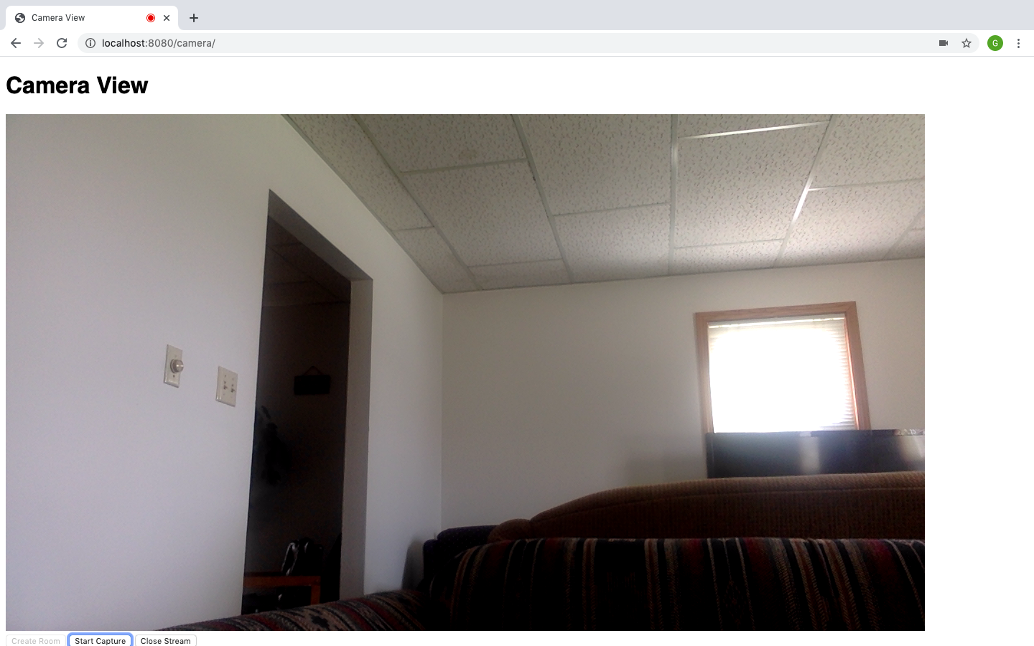
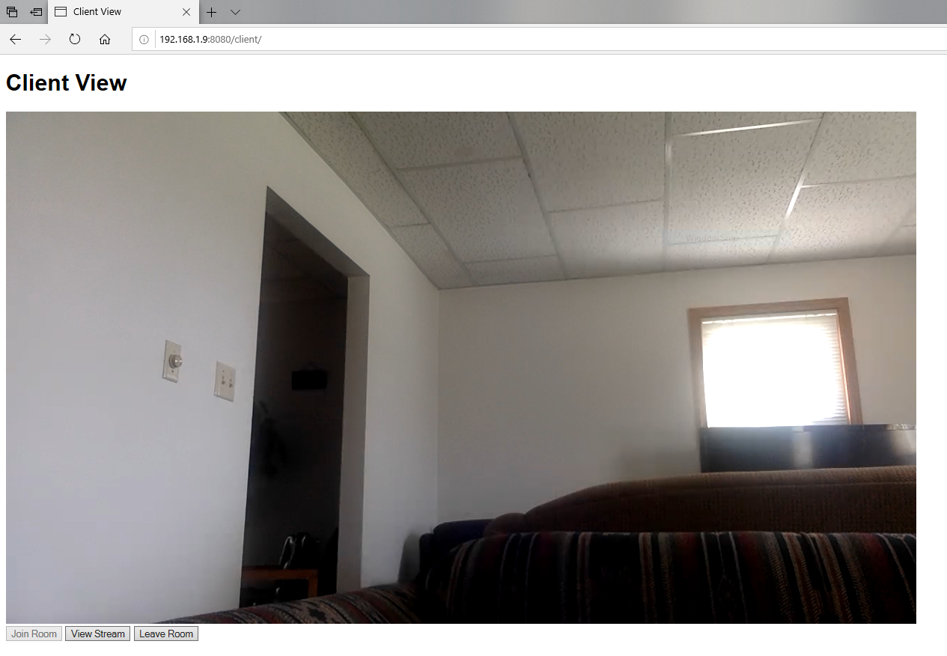
WebRTC Signaling Server Prototype
Notes:
Grayson Cox:
We are in the early stages of prototyping our signaling server. Our current implementation is written in Javascript and simply allows one client to stream video from his web cam and other clients to view the video stream.
This first screenshot shows the “Camera View”, where a user can create a “room” with a unique name and begin capturing video from the web cam. This “room” is an abstraction of a web socket connection handled by the signalling server.
The second screenshot shows the “Client View,” where a user can join a “room” that has been created by the “Camera View” by entering its unique name. Then the user can select “View Stream” to send an offer over the server, initiating the communication session and opening the video stream. To show proof of concept, these two screenshots show the same video stream from different browsers on different machines. The first screenshot shows the “Camera View” in Google Chrome on a MacBook, and the second screenshot shows the “Client View” displaying the same video stream in Microsoft Edge on a Windows machine in the local network.

Slide 24
Mesh Network Design
Raspberry Pis Running Raspbian
After initial testing switched from OpenWRT and found out devices require external wireless adapters to make use of IBSS mode
BATMAN-adv for mesh network configuration
Layer 2 (kernel space)
Transports only ethernet packets
Notes:
Austin Dvorak:
Hello, my name is austin dvorak and i will be discussing the wesh network design
As discussed before, raspberry pi 4s will be used for the network nodes. These will be running raspbian rather than OpenWRT, a common router distribution with support for raspberry pis, due to issues with configuration. From testing we found out that in order to get the network working, we will need to use external wireless adapters as raspberry pi 4s have issues with configuration to ad hoc mode.
BATMAN-adv will be used for the mesh network configuration due to the support it has, and features that include gps and topological graph generation. It runs on layer 2 in the kernel space and in such a way that to the user the network is just a local area network, meaning it transmits only ethernet packets, where batman takes over and handles the routing of packets to other nodes.

Slide 25
Conclusion

Slide 26
Current Project Status
Acquired most of the hardware needed for prototyping
Prototyping the ad-hoc network with BATMAN and Raspbian
Researching technologies for connecting network to a Spring Boot application
Displaying video streams via WebRTC
Rough prototype for user application
Fetch and display static network data
Notes:
Grayson Cox:
Hardware:
We have acquired a set of Raspberry Pi 4’s with cases. This has been enough for us to get started on prototyping our mesh network; however, we are still waiting to receive our Pi cameras. Acquiring our hardware resources has been complicated because of the switch to online instruction.
Mesh Network:
Regarding the mesh network, we are in the process of experimenting with BATMAN and Raspbian for constructing the ad-hoc network.
Network Master Node:
Next, our work on the network master node has been mostly research into technologies that can allow us to transmit live data streams from the node network to a Spring Boot application, which will transfer data to the user application.
We have a functioning prototype for connecting multiple network nodes to the server with ZeroMQ so that shell commands can be executed on the nodes remotely.
We also have the prototype signaling server for handling communication sessions over WebRTC.
User Application:
Regarding the user application, we have a functional prototype of the user application (shown earlier) written in Angular, which is capable of fetching and displaying static network information from a mock HTTP server.

Slide 27
Task Responsibilities
Grayson Cox
UI Developer and Agile Project Manager
Austin Dvorak
Network Systems Manager
Ryan Newell
Hardware Systems Admin
Spencer Parry
UI Developer
Ross Thedens
Communication Systems Manager
Meeting Secretary
Gantt Chart Creator/Savant
Notes:
Spencer Parry:
Throughout this project we have divided the responsibilities into the following roles:
Grayson- UI Developer and Agile Project Manager
Grayson has worked on developing a user facing interface as well as managed different aspects of project management, such as the managing the project repository and sprint planning. Additionally, Grayson has lead the prototyping and integration of live video streaming with WebRTC in the User Application.
Austin- Network Systems Manager
Austin has researched and implemented different pieces of software and protocols we can use with our hardware to create the mesh networking system
Ryan- Hardware Systems Admin
Ryan has researched and ordered different hardware components that we are going to use with the system, as well as confirmed that they will work with our system.
Spencer- UI Developer
Spencer has worked on developing a user facing front-end that has a good design while also being easy to use.
Ross- Communication Systems Manager and Meeting Secretary
Ross has researched many protocols and different software components that we can use to transmit camera data and other information between the nodes. He has also taken notes at all of our meetings and has kept the team website up to date with this information. Lastly, Ross is our resident Gantt Project savant.

Slide 28
Plan for Next Semester
Networking
Get BATMAN-ADV working on Raspbian
Refine configuration to connect seamlessly
User Application
Build Spring Boot application
Integrate video from sensor into a stream over WebRTC
Create a clean, user-friendly UI
Acquire the remaining materials needed
Includes batteries, cases, camera, and other miscellaneous items
Assemble the nodes
Notes:
Ryan Newell
Our plan next semester is get the ad-hoc networking to work on Raspbian with the Raspberry Pis and then to get each Pi configured so that connecting is seamless.
For the User Application, we will begin building the Spring Boot application and getting our camera video to stream over WebRTC. While we get the functionality working, we will also be working to make the UI have a nice, clean look.
We will also be researching and ordering hardware that is still needed such as the batteries, drop-proof cases, and other items that weren’t necessary for initial testing but will be needed as things begin to come together. As we get more hardware and make progress, we will start assembling the nodes and making sure that our design meets our requirements.

Slide 29
Thank You
Notes:
(Ross Thedens)
This concludes our presentation. Thank you for watching and listening.

Slide 30
Sources (for Market Survey slide)
NS-3 | A Discrete-Event Network Simulator for Internet Systems, 2020. Accessed on: Mar. 29, 2020. [Online]. Available: https://www.nsnam.org/
E. Biagioni, “A Network Testbed for Ad-Hoc Communications using Raspberry Pi and 802.11,” in Proc. of the 52nd Hawaii International Conference on System Sciences. Accessed on: Mar. 29, 2020. [Online]. Available: http://hdl.handle.net/10125/60191

